Slide 1
Computer Graphics Camera Control
László Szécsi szecsi@iit.bme.hu
AIT

Slide 2
First Person Camera
camera attached to avatar
not at the same position (would only see its inside), but moving with it
in effect it is like a game object that has the avatar as its parent
the camera’s view matrix is composed of the avatar’s model matrix and its local pose matrix computed with its relative orientation and position (and then inverted)

Slide 3
Third Person Camera
yaw, pitch, roll unknown
but we know the look-at point
i.e. the avatar’s position
the world-space base vectors of the camera are found using the camera position and look-at point
the view matrix is assembled directly using these vectors

Slide 4
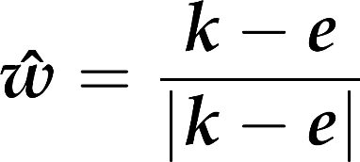
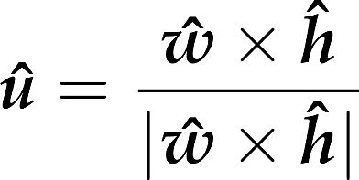







View transformation: base directions from lookat point
generic upwards
ahead
right
up
eye
y
lookat
z
x
Notes:
Vector w can be obtained from the main viewing direction (eye - lookat) by a simple normalization. The application of normalization to get v is also tempting, but simple normalization of h would not guarantee that basis vector v is orthogonal to basis vector w. So instead of directly computing v from h, first we obtain u as a vector that is orthogonal to both w and h. Then, v is computed indirectly through w and u to get it orthogonal to both of them.

Slide 5



View transformation: matrix from base directions and eye position
generic upwards
ahead
right
camera up
eye
y
z
x
Notes:
The view transformation in 3D is a translation and a rotation. This applies to ALL objects in the virtual world, camera included.
To goal is to place everything so that the camera's right aligns with the x axis and the camera's up aligns with the y axis. This is consistent with the normalized device space coordinates we had in 2D. If x points to the right ad y points up, where should z point to? Let us make an orthogonal frame using our thumb, index and middle fingers. If thumb points along x, index along y, then let the middle finger points along z. If we used our right hand, z is towards us (pointing out of the screen). If we used our left hand, z points away from us (into the screen). Both are viable conventions. OpenGL historically prefers the right-handed one. It comes with the benefit that a rotation with a positive angle around the positive z axis is counterclockwise in the xy plane, which is again the usual convention for rotations by positive angles.
We apply a transformation on the scene, including objects and the camera, that moves the camera to the origin and rotates it to make the ahead direction be axis –z and the camera’s vertical direction be axis y. To find such transformation, we assign an orthonormal basis to the camera so that its first basis vector, u, is the camera’s horizontal direction, the second, v, is the vertical direction, and the third, w, is the opposite of the ahead direction (we reverse the ahead direction to maintain the right handedness of the system).

Slide 6
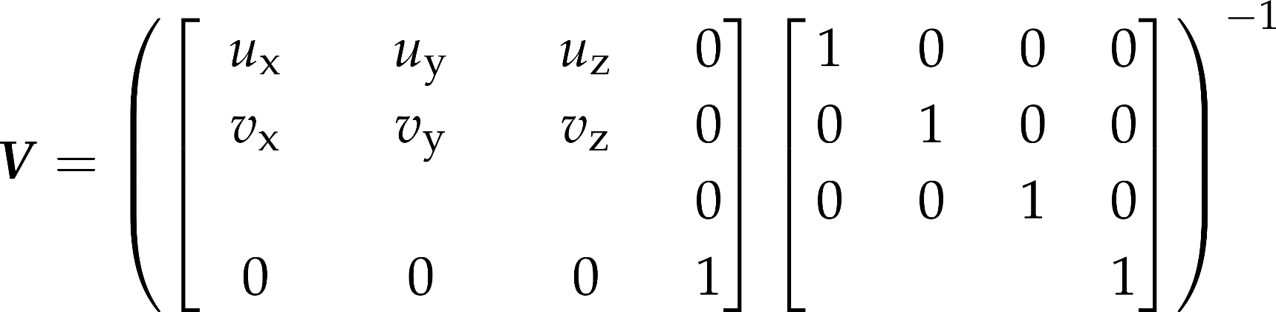
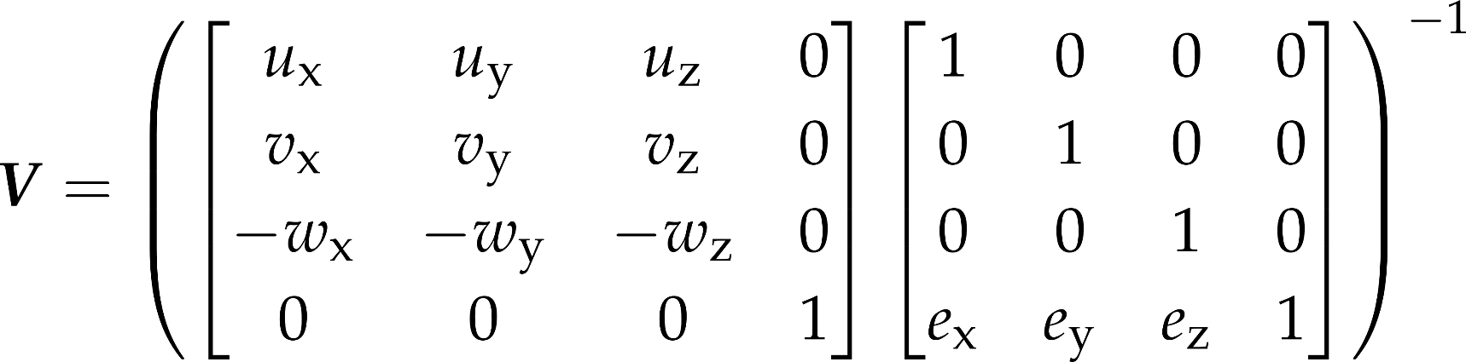
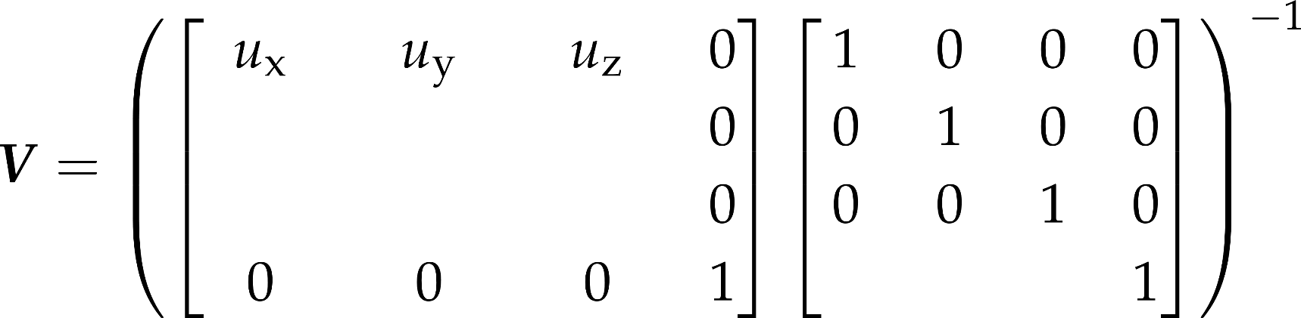
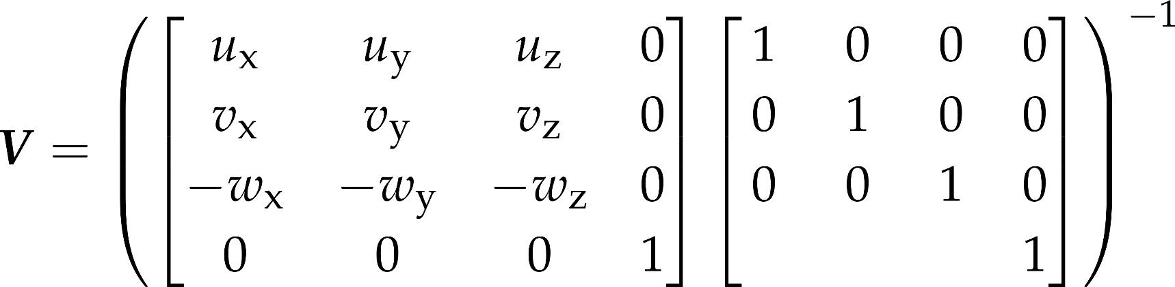
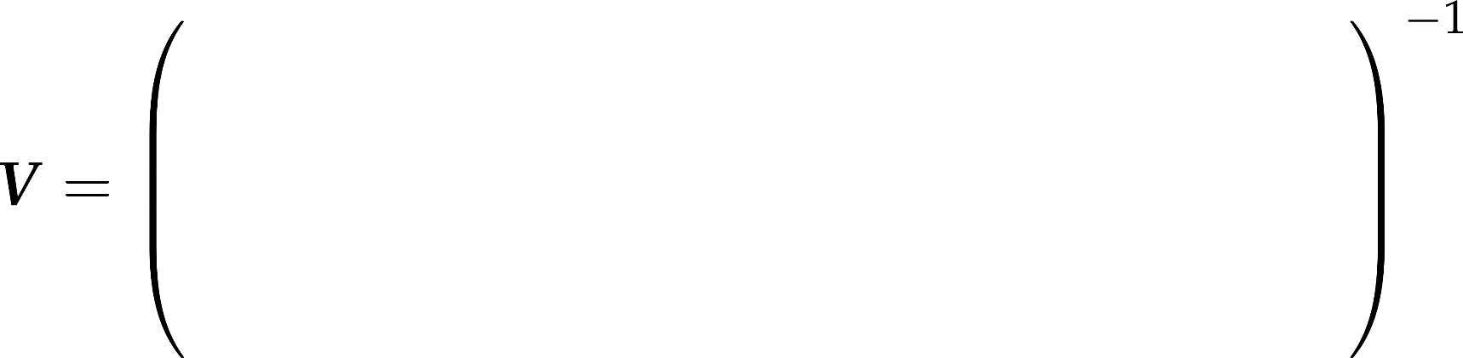
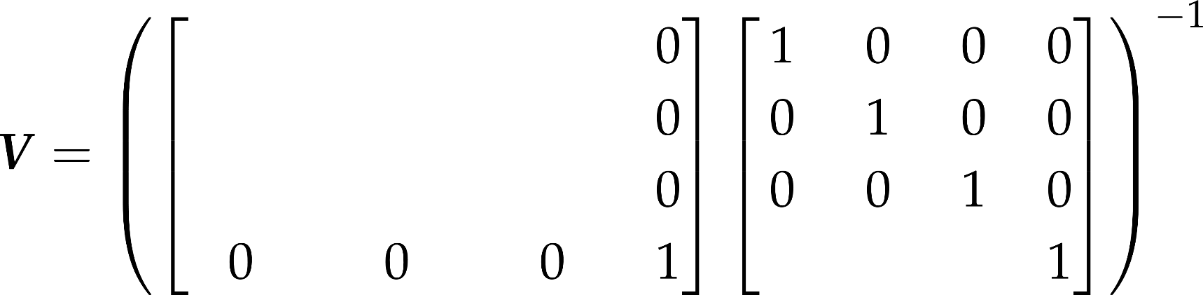

View transformation: matrix from base directions and eye position
generic upwards
ahead
right
camera up
eye
y
z
x
Notes:
The transformation we are looking for is a translation then a rotation. The translation moves the eye position to the origin. The translation has a simple homogeneous linear transformation matrix. Having applied this translation, the orientation should be changed to align vector w with axis z, vector v with axis y, and vector u with axis x. Although this transformation is non-trivial, its inverse that aligns axis x with u, axis y with v, and axis z with w is straightforward.
Its basic idea is that the rows of an affine transformation (fourth column is [0,0,0,1]^{T}) are the images of the three basis vectors and the origin respectively.
So, the transformation of x,y,z axes to u,v,w is the matrix that contains u,v,w as the row vectors of the 3x3 minor matrix of the 4x4 transformation matrix.
As we need the inverse transformation, this matrix needs to be inverted. Such matrices – called orthonormal matrices – are easy to invert, since their transpose is their inverse.

Slide 7
Generic up direction in the world
PerspectiveCamera.worldUp = new Vec3(0, 1, 0);

Slide 8
Base directions
this.right.setVectorProduct(
this.ahead,
PerspectiveCamera.worldUp );
this.right.normalize();
this.up.setVectorProduct(this.right, this.ahead);

Slide 9
Compute view matrix
this.viewMatrix.set(
this.right.x , this.right.y , this.right.z , 0,
this.up.x , this.up.y , this.up.z , 0,
-this.ahead.x , -this.ahead.y , -this.ahead.z , 0,
0 , 0 , 0 , 1).
translate(this.position).
invert();
this.viewProjMatrix.set(this.viewMatrix).mul(this.projMatrix);

